Slide 1

Natural Language Processing
Customer Rating Predictions

Slide 2
Table of Content
Introduction
Machine Learning Algorithms Used for Training Model
Assumptions and Metric used for Validating the model
Pre-Processing Steps
Feature Extraction Algorithms
Model Training
Comparison of Model
Prediction from Model/ Conclusion

Slide 3
Introduction
Problem Statement: Predict the rating of the items from the given data(Musical Instruments), using comments/reviews, determine overall rating.
This file has reviewer ID , User ID, Reviewer Name, Reviewer text, helpful, Summary, Overall, Unix Review time and Review Time Description of columns in the file:
reviewerID - ID of the reviewer
asin - ID of the product
reviewerName - name of the reviewer
helpful - helpfulness rating of the review
reviewText - text of the review
overall - rating of the product
summary - summary of the review
unixReviewTime - time of the review (unix time)
reviewTime - time of the review

Slide 4
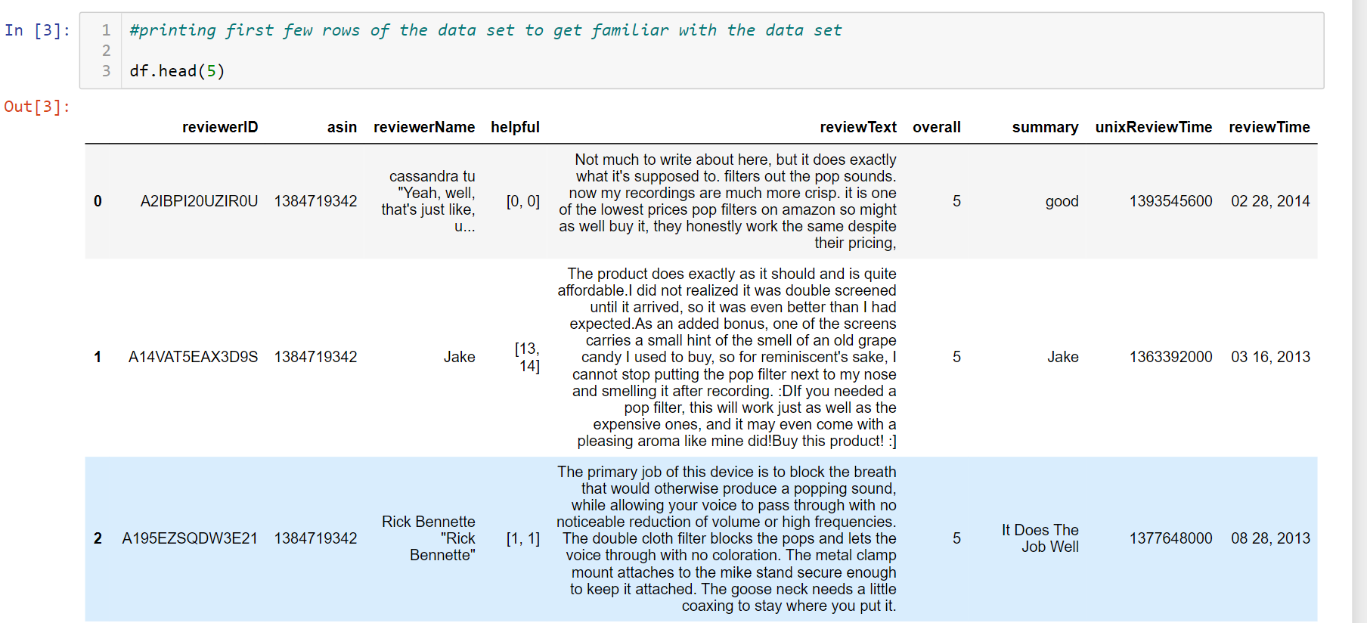
Data Exploration
Printing first few rows of Data to get familiar with the data set

Slide 5
Data Exploration
Total Number of Rows in a Data Set is : 10261
Total Number of Columns in a Data Set is: 9
Null Values in The Data Set: 27 rows for reviewer name is having null values other than that all the columns have valid values.
For Our Prediction we only need reviewText and summary so we will drop all the other unnecessary columns from the data set.
There are no duplicate rows in the data set
After dropping unnecessary columns, we will merge the reviewText and summary into one column.

Slide 6
Machine Learning Algorithm used for training a model
We will use 3 different Machine Learning Algorithm for Training our Model that are:
Naïve Bayes
Logistic Regression
Random Forest Classifier
Ensemble Algorithm

Slide 7
Assumption and Metrics used for Validating Model
Assumptions:
We will use ASCII values ranging between 0-127
We will only use Verbs, Adverbs, Nouns and Adjectives from the sentence.
Metrics Used:
Precision = TP / (TP + FP)
Recall = TP / (TP + FN)
Accuracy = (TP + TN) / (Total)
F1 Score
ROC AUC score

Slide 8
Pre-Processing Steps
In Sentiment Analysis from text Pre-Processing plays, crucial role since text could contain anything like punctuations, jargon, or numeric value which needs to be cleaned using these steps since these words don’t have influence on the sentiment score.
Steps followed for pre-processing are:
Merging the ratings into two classes bad(ratings 1,2 and 3) and good(ratings 4 and 5)
Converting the text into lower to make the complete text consistent
Removing the non-ASCII values
Fixing the abbreviations eg: that’s to that is etc.
Removing unnecessary words such as internet links if any, numeric values, mention(@), and alpha numeric values
After all the above steps we will perform lemmatization by removing stopwords and punctuations in the sentence.

Slide 9
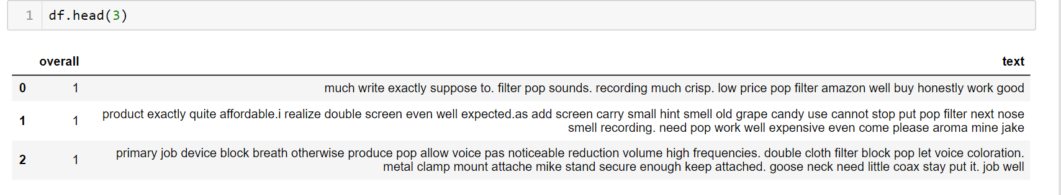
Data After Pre-Processing
After removing all the unnecessary words from the text, it only has words which are required for finding the sentiment scores

Slide 10
Feature Extraction Algorithm
Machine Learning algorithms only understand numeric values, so we must convert strings into the meaningful numeric values. To convert strings to numeric values we will use two algorithms that are:
TFIDF – Term Frequency Inverse Document Frequency – TF-IDF is a measure of originality of a word by comparing the number of times a word appears in the data set with the number of rows the words appear in.
Bag of Words or Count Vectorizer - Count Vectorizer give number of frequency with respect to index of vocabulary

Slide 11
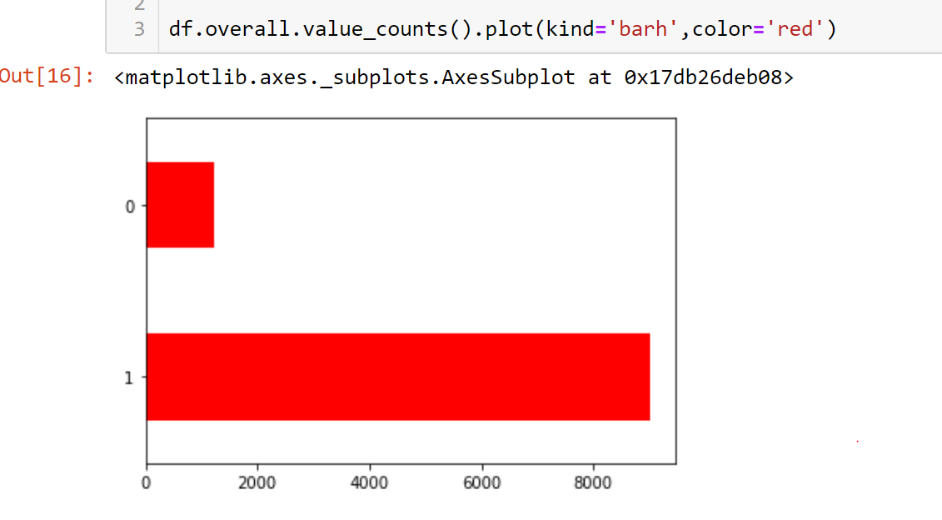
Feature Extraction Algorithm
After converting the strings into numeric values, we will check for the imbalance in the data set for two classes. We can clearly see that there is class imbalance issue with almost 85% of the data having 1. if our model only predicts 1 correctly Accuracy of our model would be 85% which is not good. To handle this, we must perform some sampling techniques.
Over Sampling
Under Sampling

Slide 12
Model Training
To Train a model we will create a pipeline and include all the feature extraction steps into it.
We will include Naïve Bayes, Logistic Regression and Random Forest Classifier in our pipeline and check for the validation metrics.
After validating the model will decide which one is better.

Slide 13
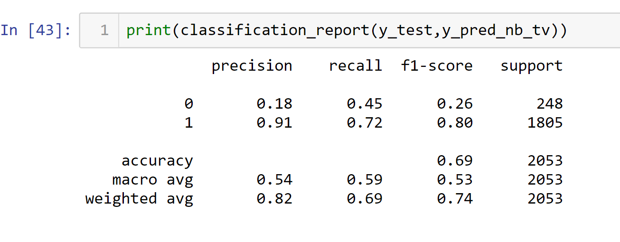
Comparison of Model
Classification report of Naïve Bayes Algorithm with TFIDF

Slide 14
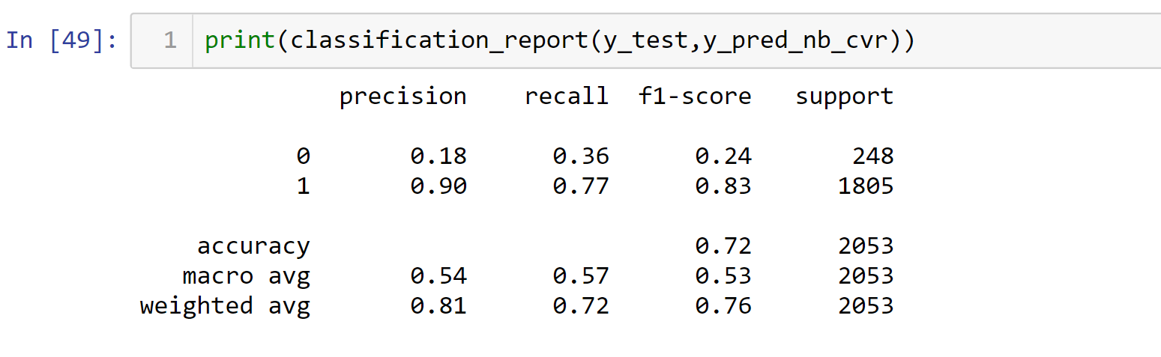
Comparison of Model
Classification Report of Naïve Bayes with Bag of Words

Slide 15
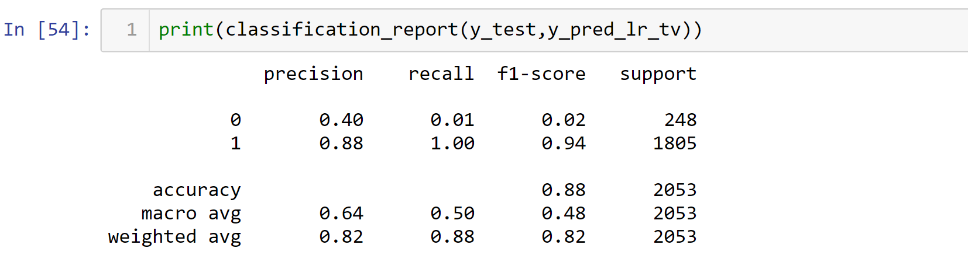
Comparison of Model
Classification Report of Logistic Regression with TFIDF

Slide 16
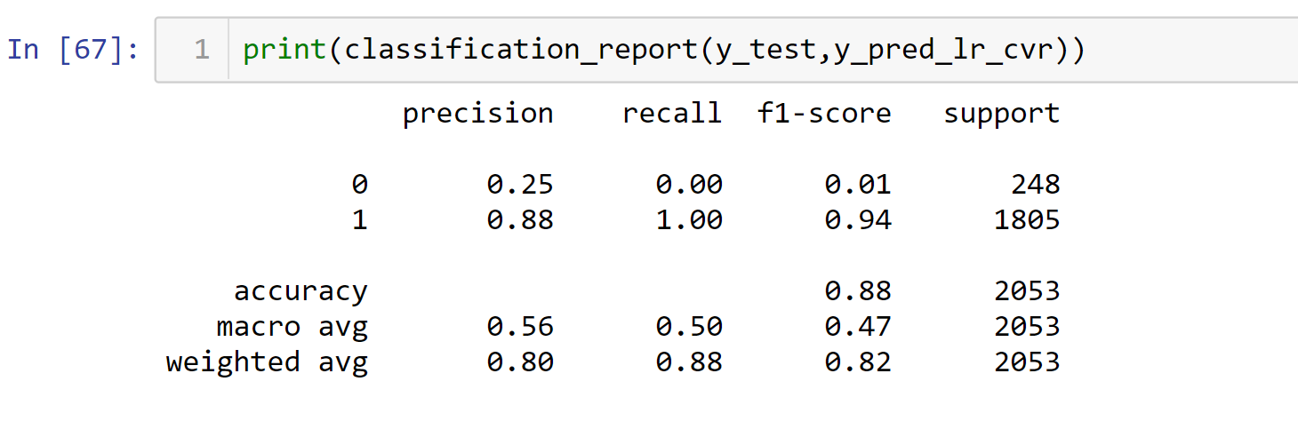
Comparison of Model
Classification Report of Logistic Regression with Bag of Words

Slide 17
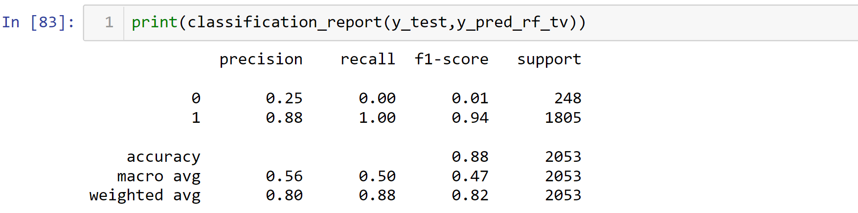
Comparison of Model
Classification Report of Random Forest Classifier with TFIDF

Slide 18
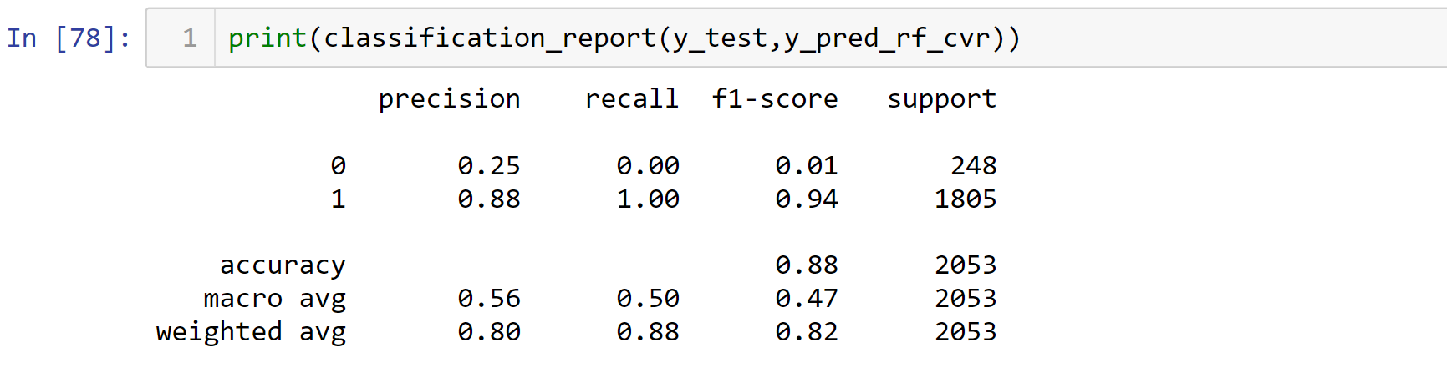
Comparison of Model
Classification Report of Random Forest Classifier with Bag of Words

Slide 19
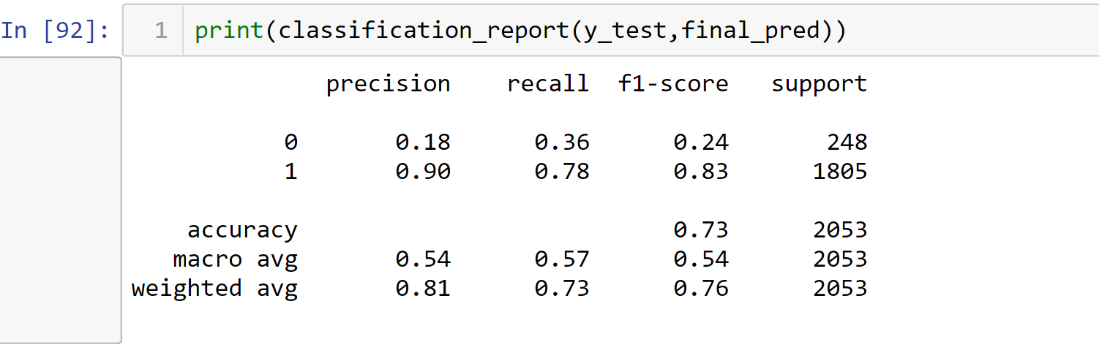
Prediction from Model/Conclusion
From our Classification reports we can clearly see that Naïve Bayes performed well then Logistic and Random Forest using any vectorization technique (TFIDF or Bag of Words).
We will use ensemble of Naïve Bayes with TFIDF and Bag of words along with Logistic regression with TFIDF for our final prediction.

Slide 20
Conclusion
Out of all the algorithms we have used ensemble Algorithm performed well with this data set for predicting the ratings from the text.
We can improve the prediction by using Neural Networks. We can also add steps to track emoticons to get a good score for sarcastic comments.

Slide 21
Thank You

